Slide 1
File Handling
Introduction
Data Files
Opening and Closing the Files
Reading and Writing Files
Standard Input, Output and Error Stream
By: Mohit Bisht

Slide 2
File Handling
Files are named locations on disk to store information. They are used to permanently store data in a non-volatile memory (e.g. hard disk). Example: word file. Excel file, text file,database file,music file, video files etc
Since Random Access Memory (RAM) is volatile (which loses its data when the computer is turned off), we use files for future use of the data by permanently storing them.
When we want to read from or write to a file, we need to open it first. When we are done, it needs to be closed
Every programming language supports File Handling,Python too supports file handling and allows users to handle files i.e., to read and write files, along with many other file handling options, to operate on files.
A file operation takes place in the following order:
Open a file Read or Write(Perform operation) Close the file

Slide 3
Data Files
A data file is any file containing information, but not code; it is only meant to be read or viewed and not executed
Text File:
A text file is a computer file that only contains text and has no special formatting such as bold text, italic text, images, etc.
Text file stores information in ASCII or Unicode characters, Each line of text terminated with special character know as EOL (End of Line).
Binary File(Raw File)
When data is stored on a computer, it is stored in the form of binary. A binary file could therefore refer to any computer file, as they are all made up of binary numbers.
In binary file no EOL, No translation or specific encoding, As a result binary files are faster and easier for a program tp read and write than text files. As long as file does not need to be read by people or need ported to different type of system, binary files are the best way to store information.

Slide 4
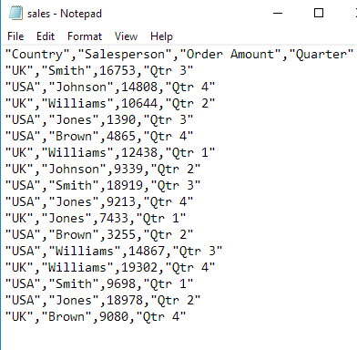
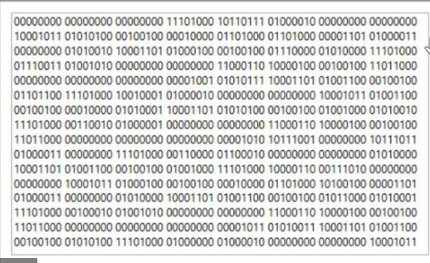
Text File
Binary FIle

Slide 5
Opening File:Open(Filename,Mode)
file_object=open(filename)
Python will look for this file in current working directory, Open file in read mode(default mode)
file_object=open(filename,mode)
file=open(“c:\\main\\test.txt”)
The above statement opens the file “test.txt” in the path:c:\\main\\
file=open(“c:\\main\\test.txt”)
Why double slashes?
To avoid or suppress the special meaning of sequence,We can use like below also
file=open(r“c:\main\test.txt”)
Example: File=open(“c:\tab\test.txt”) This might give incorrect result as \t is tab character
What is file object?
File=open(“c:\tab\test.txt”) , Python stores the reference of mentioned file in the file object, A file object is stream of bytes where data can be read either byte by byte or line by line or collectively

Slide 6
Closing File <fileHandle>.close()
In Python, files are automatically close at the end of the programme but is good practice to get into habit closing of file.
Why need to close? The OS may not write the data out to the file until it is closed , If program exit unexpectedly there is a danger that your data may not have been written to the file.
file_object=open(filename)
file_object.close()
A close() function breaks the link of file object and file on the disk, After close() no task can be performed on the file

Slide 7
File Access Modes
Text File Mode | Binary File Mode | Description | Important Points
r | rb | read only | File must exist otherwise Python raise error
w | wb | write only | File is in write only mode If file does not exist, file is created Not overwrite, append the existing file
a | ab | append | File is in write only mode If file does not exist, file is created Not overwrite, append the existing file

Slide 8
Text File Mode | Binary File Mode | Description | Important Points
r+ | r+b or rb+ | read and write | File must exist otherwise Python raise error Both reading and writing operation
w+ | w+b or wb+ | write and read | If file does not exist, file is created If file exists, Python will overwrite the file Both write and read operation
a+ | a+b or ab+ | append and read | If file does not exist, file is created Not overwrite, append the existing file Both reading and writing operation

Slide 9
Reading from files: Python provide three methods to read the file
Method | Syntax | Description
read() | <filehandle>.read([n])] | Read at most n bytes;if no n is specified, reads the entire file file=open("C:\\Users\\Mohit Bisht\\Desktop\\test.txt",'r') read=file.read() print(read) file.close() Output: python programing
readline() | <filehandle>.readline() | Read a line of input; if n is specified reads ar most n bytes Returns the read bytes in the form of a string ending with character or return a blank string

Slide 10
readlines() | <filehandle>.readlines() | reads all lines and returns them in list. file=open("C:\\Users\\Mohit Bisht\\Desktop\\test.txt",'r') read=file.readlines() print(read) Output:['python programing']

Slide 11
Assignment Questions:
Read a file first 30 bytes and printing it.
Read n bytes and then read reading some more bytes from the last position read.
Read a file entire content
Reading a file first three lines - line by line
Display the size of the file after removing EOL characters, leading and trailing while space and blank line
Write a program to display the number of lines in the files.
Write a program to count number of “in” present in the file.
Write a program to count number of time word “india” present in the file.

Slide 12
Writing onto Files
Name | Syntax | Description
write() | <filehandle>.write(str1) | Write string str1 to file file=open("C:\\Users\\Mohit Bisht\\Desktop\\test.txt",'w') read=file.write("Python Program") file.close()
writelines() | <filehandle>.writelines(L) | Write all the string in the list l. file=open("C:\\Users\\Mohit Bisht\\Desktop\\test.txt",'w') read=file.writelines(["Python Program","Jave Program"]) file.close()

Slide 13
Appending a file
When you open file in “w” mode , Python overwrite the existing file and old data deleted
When you open file in “a” append mode, File opened in append mode retains old data and allowing you to add new data into it.
Method remain same write and writelines
Example:
fileout=open(“student.txt”,a)
for i in range(0,3):
student=input(“Enter the student name: “)
fileout.write(student)
fileout.write(“\n”)

Slide 14
Assignment questions
Write a python program which create file “student.txt” and write school name on the respective file.
Write a python program with mode “w” which create file “student.txt” and add below data
-Aman
-Rahul
-Sita
-Ram
Write a python program which ask below input from user and create the file with following data separated by comma..
Name of student, Roll number, Garde
Write a python program which add student data in above file created again without deleting existing data.

Slide 15
flush() function: <fileObject>.flus()
Python holds everything to write in the file in buffer and pushes it onto actual file on storage device a later time.
flush() function force python to write the contents of buffer onto storage.
Python automatically flushes the files when closing them i.e. this function is implicitly called by the close() function.
f =open("C:\\Users\\Mohit Bisht\\Desktop\\out.log","w+")
f.write("Python Program \n")
f.flush()
f.write("Java Program \n")
f.flush()
f.close()

Slide 16
Removing whitespaces after Reading from File.
All read function also read the leading and trailing whitespaces i.e., spaces or tabs or newline characters. If you want to remove any of these leading and trailing we can use below functions.
strip() : removes the given character from both ends.
rstrip(): remove the given character from trailing end i.e. right end.
lstrip(): remove the given character from leading end i.e. left end
f=file(“poem.txt”,r)
l=f.readline()
l=l.rstrip(“\n”)
f.close()

Slide 17
Significance of File Pointer in File Handling(Book Marker)
Every file maintain file pointer which tells current position in the file where writing or reading take place.
Whenever we read or write the file below operation take places.
Read write operation take place at the position of file-pointer and file file pointer advances by the specified number of bytes.
f=open(“test.txt”,r)
ch=f.read(1)
P | y | t | h | o | n | .
P | y | t | h | o | n | .

Slide 18
File modes and opening position of File-Pointer
r,rb,r+,rb+,r+b | Beginning of the file.
w,wb,w+,wb+,w+b | Beginning of the file
a,ab,a+,ab+,a+b | At the end of the file

Slide 19
Standard input, output and error streams
Standard input device(stdin)-Reads from the keyboard.
Standard output device(stdout)-print to the display and can be redirected as standard input,
Standard error device(stderr)-Same as stdout but normally only for errors.
Import sys
f=open(”test.txt”)
l=f.readline()
sys.stdout.write(l)
f.close()

Slide 20
Absolute and Relative Paths
Path: A path is a unique location to a file or a folder in a file system of an OS.A path to a file is a combination of / and alphanumeric characters.
Absolute path: An absolute path is defined as the specifying the location of a file or directory from the root directory(/).
C:\Documents\Newsletters\Summer2018.pdf
An absolute file path from the root of drive C:
Relative path is defined as the path related to the present working directly. Itt starts at your current directory.
2018\January.xlsx

Slide 21
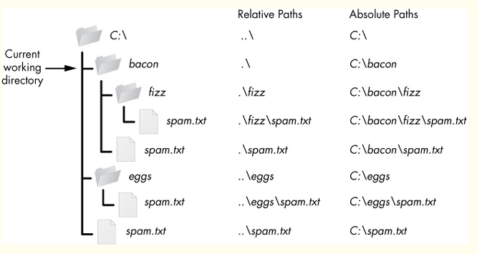

Slide 22
Assignment
What is the difference between read() and readlines() function?
What is the difference between readline() and readlines() function?
Write a function longline() that accepts a filename and reports the file longest line?
What is the output of below line of code?
out=file(“test.txt”,w)
out.write(“Hello Python\n”)
out.write(“Tell me about math lib”)
out.close()
Write a function remove_lowercase() that accepts two filenames, and copies all the lines that do not start with lowercase letter from the first file to second file?
What is the output of below code?
file(“c:\\test.txt”,”r”).readline().split()
What is the output of below code?
file(“c:\\test.txt”,”r”).readline()

Slide 23
Assignment
The file “test.txt” contain the following:
Hi My name is Sumit
I lives in chennai
I love playing basketball
For above file consider below line of code, What will be the output?
file=open(“test.txt”,”r)
s1=file.readline()
s2=file.readline()
s3=file.read(10)
print(s3)
file.close()
What is the output of below code?
file=open(“test1.txt”,”w”)
file.write(“India capital is Delhi”)
file.write(“India have 29 states”)
file.write(“India national animal is Tiger”)
file.close()

Slide 24
Assignment
What is the output of below code?
file=open(“test1.txt”,”w”)
file.write(“India capital is Delhi \n”)
file.write(“India have 29 states \n”)
file.write(“India national animal is Tiger \n”)
file.close()
Write a program that reads the text file and print all the digits present in the file.
Read the code given below and answer the question:
fh=open(“test.txt”,”w”)
fh.write(“bye”)
fh.close()
If the file contains “GOOD” before execution, what will be the contents of the file after execution of
this code.

Slide 25
Assignment
What would be the output of below code”?
fh=open(“test.txt”,r)
l=fh.readlines()
print(l[0],end=””)
print(l[2],end=””)
print(l[5],end=””)
print(l[1],end=””)
fh.close()
Write code to print just the last line of a text file “data.txt”.
Write a program that copies a text file “source.txt” onto “target.txt” barring the line starting with “@” sign
What is the difference between mode “w” and “a”?
When a file is opened for output, what happen when
Mentioned file not exists
The mentioned file does exist
What role is played by file modes in file operation?

Slide 26
Assignment
What is the advantage of saving data in binary file?
How are following code differ from one another?
1.f=open(“test.txt”,”r”)
f.read()
2.f=open(“test.txt”,”r”)
f.read(100))
What following code doing?
f=open(“contacts.csv”,”a”)
name=input(“Enter the name: “)
phone=input(“Enter the phone:”)
file.write(name+”,”+phone+”\n”)
Consider above contacts.csv created, Then figure out what below code trying to do?
name=input(“enter the name: “)
f=open(“contacts.csv”,”r”) n1=0
for l in f:
If name in l:
print(l)

Slide 27
Assignment
Consider the file “test.txt” , Predict the output of below program
f=open(“test.txt”,”r”)
n=0
For l in f:
n+=1
print(n)
Write a method in python to read the content from a test.txt line by line and display same on screen
Write a method in python to write multiple line of text contents into a text file.
A file sports.dat contains information in the following format : Event-Participant, Write a function that would read the content of sports.dat and create a file named Athletic.dat copying only those records from sports.dat where the event name is “Athletics”
A file contains a list of telephones in below format:
Ram 72546465
Siita 78446036
Write a program to read file and display its content in two columns
Write a program which count number of uppercase alphabets in the given file.

Slide 28
Assignment
Write program which append the content of other file onto source file.
Wrote a program which read the characters from keyboard one by one, All the lower case characters stores in “lower.txt” and all the uppercase characters stores in “upper.txt”

Slide 29
Thanks You :)

